Slide 1
Breast Cancer
Genetics Algorithms modifications to breast cancer
Machine Learning
2021/2022

Slide 2
Breast Cancer
Big Data Project
Ahmed Samir Afifi
Asmaa Shawky Younis
Aya Shrief Elasmar
Hekmat Gamal AbouElNassr
Yomna Bahaa Eldeen AbdElSattar

Slide 3
Abstract
Genetic algorithm is one of the most applicable techniques in smart technologies
Several breast cancer mRNA classification studies have stratified breast cancer and identified gene groups that correlate with outcomes. However, the number of genes used to predict patient outcome or identify tumor subtypes through RNA expression studies is variable, does not overlap, and generally requires specialized techniques beyond those used in a routine pathology laboratory. It would be ideal if genetic insight and artificial intelligence were combined with more than one algorithm such as the Genetic Algorithm for DNA-based analysis to predict patient outcomes.
Genetic algorithms have been used in conjunction with machine learning algorithm like k-fold, decision tree..etc. in different ways. For example, this article used Genetic algorithms to set the weights and bias in fixed architectures. The aim of genetic algorithms is to choose the optimal values for weights and bias for more algorithm to give more accurate diagnosis.
The GA maintains a population of n chromosomes with associated the following fitness values.

Slide 4
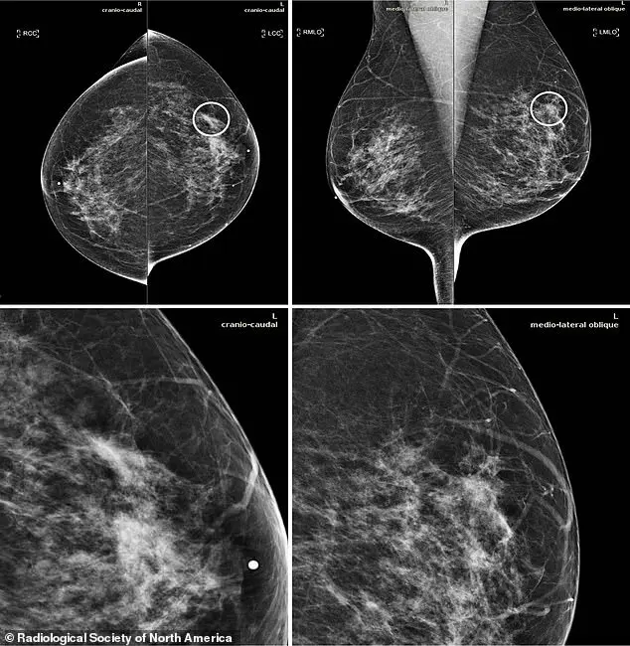
Introduction
The AI system succeeded in detecting breast cancer just like doctors, without knowing any information about patients' past medical history, and the incidence of misdiagnosis - whether false positive or false negative - decreased significantly.
Meanwhile, AI-based algorithms represent a promising way to improve the accuracy of digital mammography.
Developers are training the AI on previous available radiographs, teaching the software to recognize defects associated with cancer cells and separate them from benign findings.
In the new study, an AI system was designed to identify suspicious areas of breast cancer on 2D digital mammograms and assess the potential for metastasis to spread.
The AI system is fed a complete set of four views consisting of a mammogram image, and produces a set of image positions with the degree of suspicion of the affected cells.

Slide 5
55% : 85%
The risk of infection ranges between 55% and 85%.
50% : 85%
When there is the genetic mutation between 50% and 85% all over the world.
45%
Change in other genes of the breast in the world of women.

Slide 6
statistics
0.5%
22%
The rate of males infection in the whole world
The rate of females infection in the whole world
The effect of genes on both men and women in the world during one year
It is the most common injury in women.
As the disease rapidly worsens,
The genetic algorithm is one of the most accurate algorithms for disease classification.

Slide 7
Genetic Algorithm
**Initial Population** – Initialize the population randomly based on the data.
**Fitness function** – Find the fitness value of the each of the chromosomes(a chromosome is a set of parameters which define a proposed solution to the problem that the genetic algorithm is trying to solve)
**Selection** – Select the best fitted chromosomes as parents to pass the genes for the next generation and create a new population
**Cross-over** – Create new set of chromosome by combining the parents and add them to new population set
**Mutation** – Perform mutation which alters one or more gene values in a chromosome in the new population set generated. Mutation helps in getting more diverse opportunity. Obtained population will be used in the next generation

Slide 8
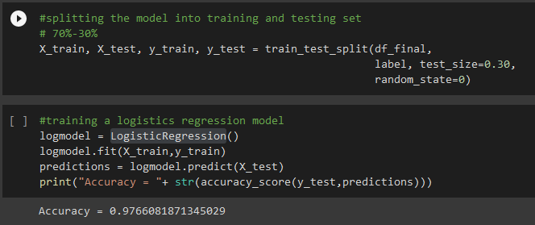
Genetic Algorithm Results
Through the application of Algorithms
And data division, application of other types, and disease prediction, results have been shown that exceed 97% for Logistic Regression but the K-Fold = 98% and confusion matrix = 99%.

Slide 9
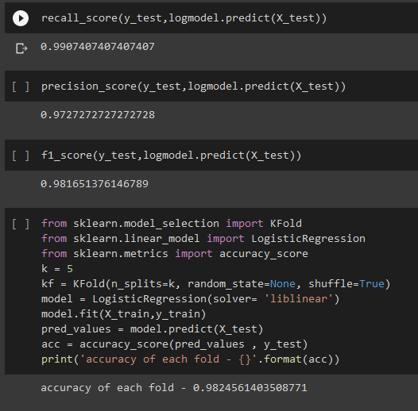
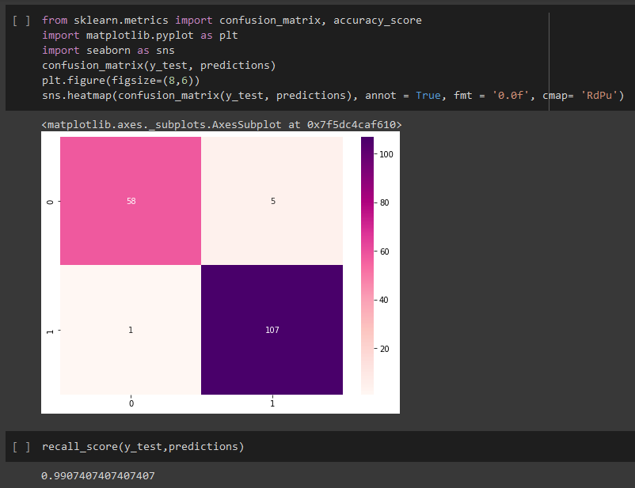
Genetic Algorithm Results

Slide 10
Conclusion
This article discussed the possibility of using genetics algorithm model to optimize the genetics algorithm of breast cancer.
The purpose was to achieve a better prediction accuracy by
the use of GA-DT, K-fold and Logistic Regression hybrid technique.
Test results for the diagnosis of breast cancer show that the hybrid technique generally gives accurate results, and thus the purpose has been achieved.
The genetic algorithm displays the following results in the run solver and view results pane.

Slide 11
Thank you
Insert the title of your subtitle Here

